Slide 2
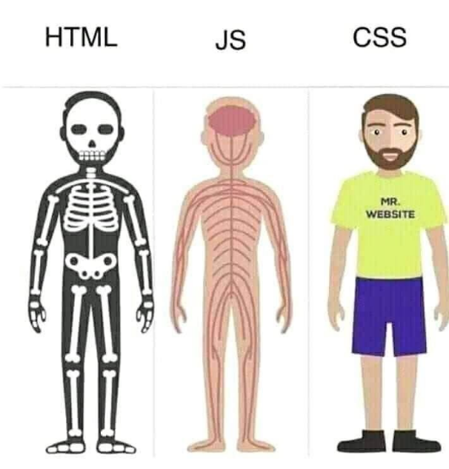
Going deeper with webserver setup
HTML is the structure
JS is the functionality
CSS is the styling

Slide 4
Creating a webpage – part 1
It all starts with making a constant local variable index_html[] which is an arrary used to hold a sequence of characters (our webpage)
Now we can create the contents inside the R”name(
We declare the document type as HTML5. The entire webpage starts with <HTML> and ends with </HTML>
The <head> section of the HTML doc is where all meta data is contained, meaning content that is not directly represented on the webpage.
Notes:
R”()” syntax allows to to create strings without escaping special characters, you can use what ever delimiter name inside the paranthesis.
PROGMEM means that whatever is inside the R”()” gets put in the flash memory of the MCU instead of precious RAM memory.
Flash memory (non-volatile) will be keept in the MCU when power is turned off. RAM memory (volatile) will loose its data when poer is turned off.
<!DOCTYPE HTML> specifically declares the document as HTML5 which is the newest version of HTML. Which is used for mordern web development.
the <head> section is underlying functionality not dicrectly represted on the webpage.
typically used to include metadata, link to external resources, and setting global configurations for the HTML document.
-This includes the declaration of CSS styles and other meta-information that doesn't directly represent content on the page.

Slide 5
Creating a webpage – part 2 – inside the head (meta) elements
<title> : The title which is diplayed in the webbrowser
<meta> : contains various attrubtes providing additional information about the document: could be
<style> : has many attributes, and you can give specific elements and classes different styles:
We end the <head> section like this:
Notes:
Attributes in the <meta> element:
name=viewport: Used for responsive web design to control the viewport behavior on different devices.
content="width=device-width, initial-scale=1.0” : sets the width of the viewport to the width of the device using the webpage.
Attributes in the <style> element: (CSS) - There are many attributes, i will cover are few basic ones related to our webpage:
Styling for the html element:
font-family: Arial;: This sets the font family for the entire HTML document to Arial.
display: inline-block;: This sets the display property of the html element to inline-block. This is an interesting choice, as it makes the entire HTML document behave like an inline-block element, which can affect its layout in certain situations.
text-align: center;: This centers the text content within the html element.
Styling for h2 elements:
font-size: 3.0rem;: This sets the font size for all h2 elements to 3.0 rem units. rem (root em) is a relative unit that is calculated based on the font size of the root (in this case, the html element).

Slide 6
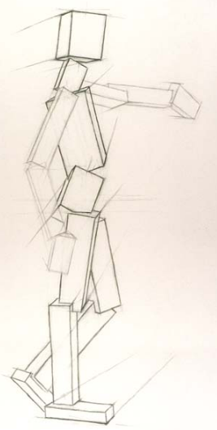
Creating a webpage – part 2 – forming the body
Everything placed between the opening <body> tag and the closing </body> tag is what users see and interact with when they visit the website.
Content Structure: give an example of content structure?
Scripts and Styles: give an example of Scripts and/or styles?
Event Handling: give an example of event handling?
In summary, the <body> section is where the main content of your webpage resides, and it plays a crucial role in defining the structure and user interface of your website.
Notes:
Content Structure: includes headings (<h1>, <h2>, etc.), paragraphs (<p>), lists (<ul>, <ol>), images (<img>), links (<a>), forms (<form>)
Scripts and Styles:
JavaScript code (enclosed in <script> tags) that provides interactivity and dynamic behavior is often placed within the <body> section.
CSS styles (typically linked using <link> or defined using <style>) can also be included to control the visual appearance of the content.
Event Handling:
Events and event handlers, such as onclick, onmouseover, etc., are often associated with elements within the <body> section to make the page interactive.

